Slide 1
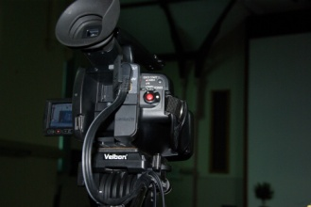
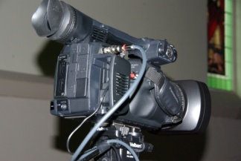
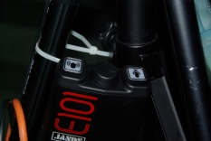
MorialtaUCA – BOW connections
V3 updated 21-june2018
Camera 5
Panasonic
AG_HMC41
Camera 6
Panasonic
AG_AC130a
Camera 7
Sony
Hassett
Camera 8
Panasonic
AG_AC130a
Intercom
cam1
Intercom
cam2
Intercom
cam3
Intercom
cam4
Intercom
Church ops
Splitter
Contr room
Splitter
desk
Patch bay on desk
Sockets wired in Parallel
Audio
From desk
Vision Switch
ATEM
Vision Switch
old
Computer
Input 4
Power
Supply
26-32V
Preview
Screen
SDI-HTMI
HTMI Splitter
Cam Contr
Vision Sw
Director
Program
Screen
Proj Screen
on proj desk
Foyer Screen
Store room screen
Blackmagic recorder
A/V splitter
Audio mon amp
SDI Video
Pins for new beltpacks
Ground
Power
Signal
HTMI connections
15 Pin VGA
Intercom
Audio

