Slide 1
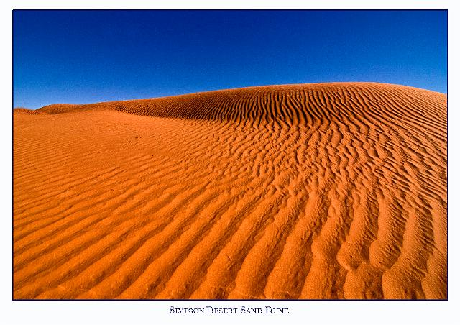
Where wide sky rolls down and touches red sand,
TiS 188

Slide 2
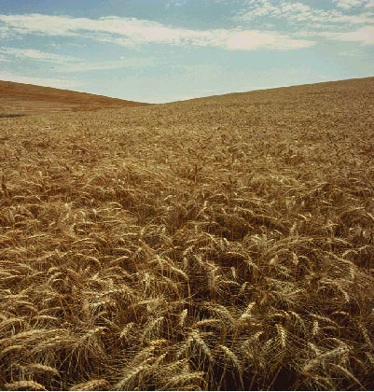
where sun turns to gold the grass of the land,

Slide 3
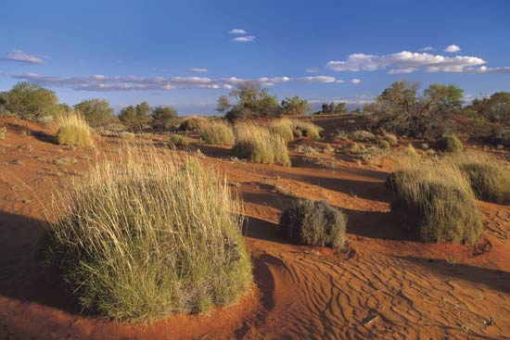
let spinifex, mulga and waterhole tell

Slide 4
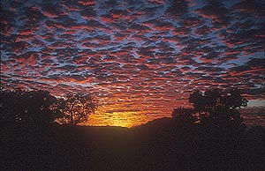
their joy in the One who made everything well.

Slide 5
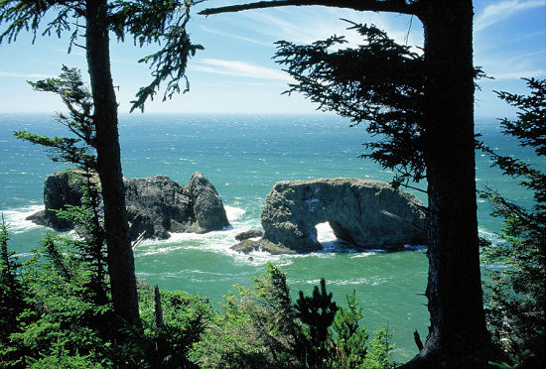
Where rain-forest calm meets reef, tide and storm,

Slide 6
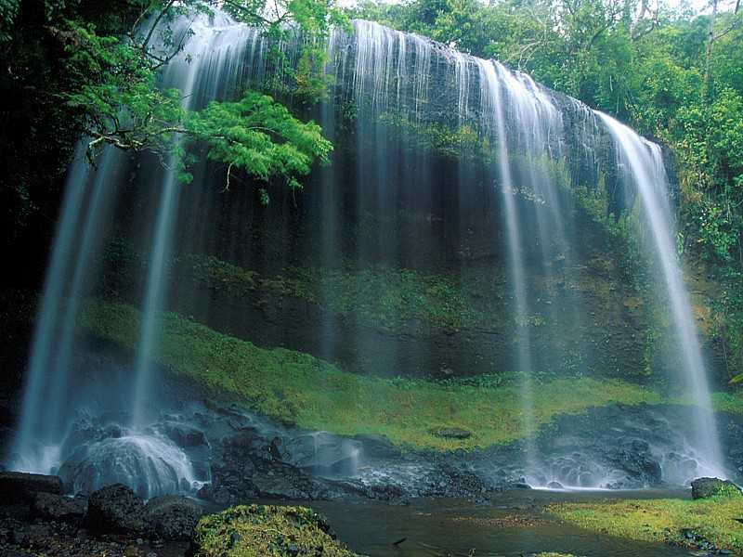
where green things grow lush and oceans are warm,

Slide 7
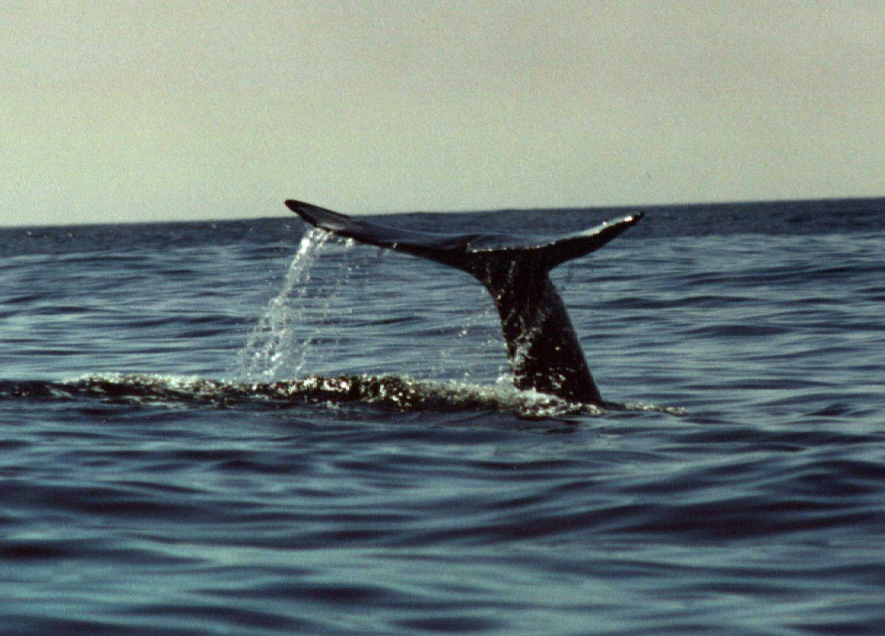
let every sea-creature and tropical bird

Slide 8
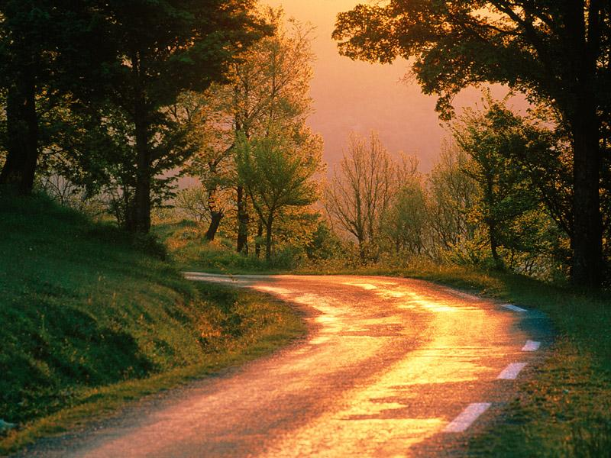
exult in the light of the life-giving Word.

Slide 9
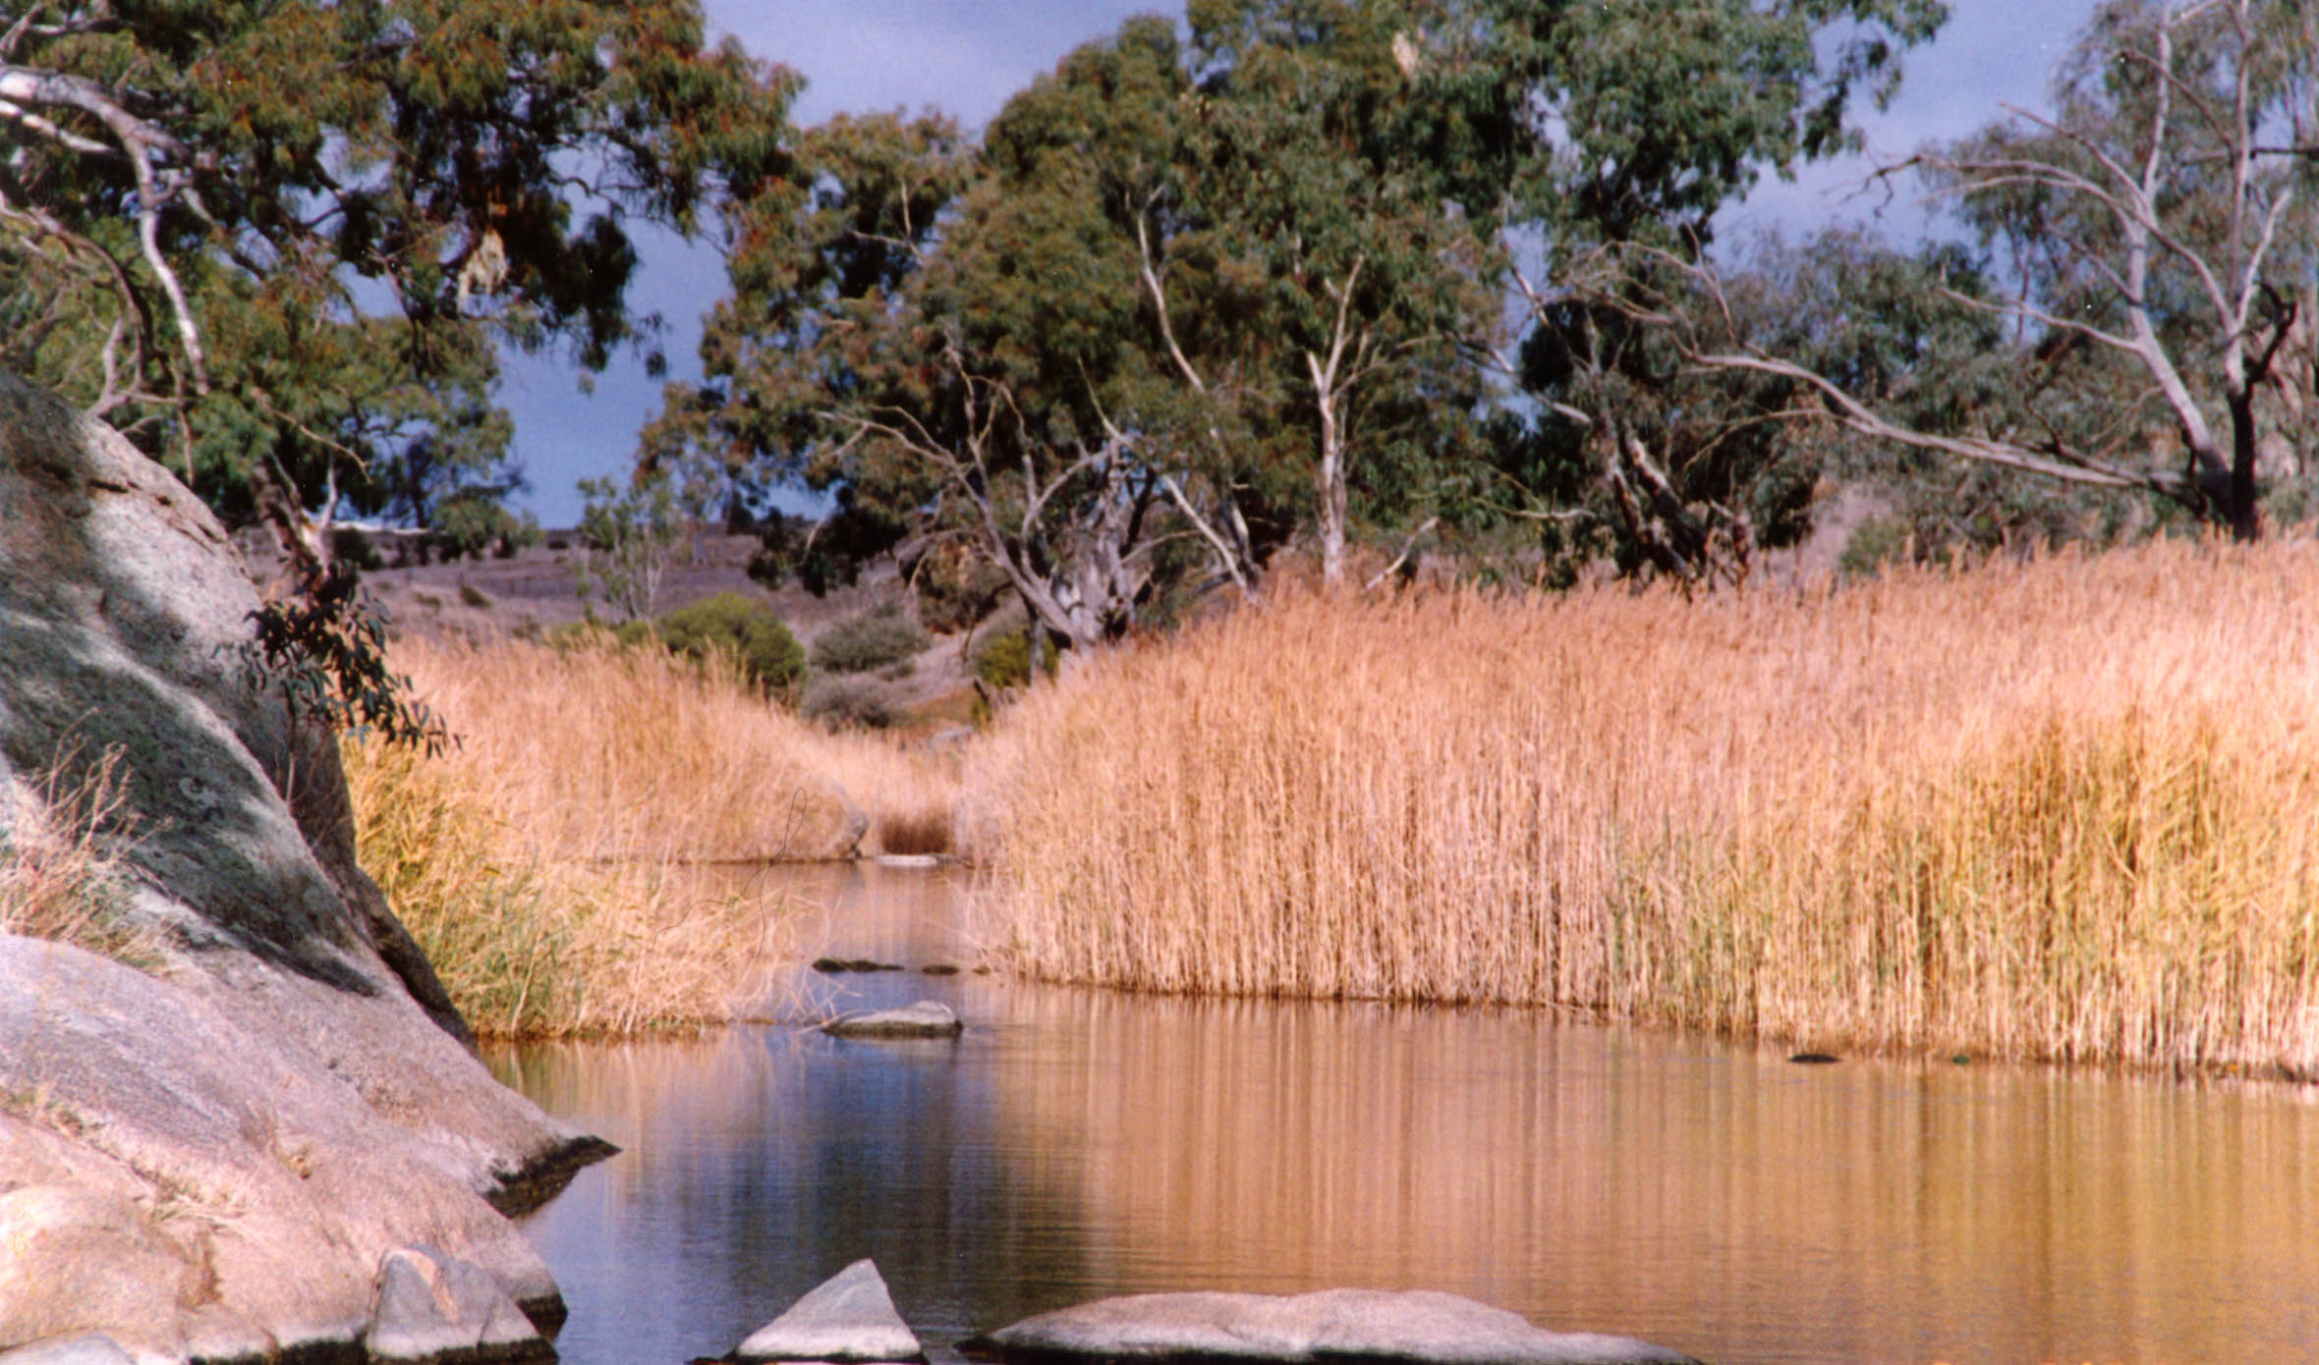
Where red gum and creek cross hillside and plain,

Slide 10
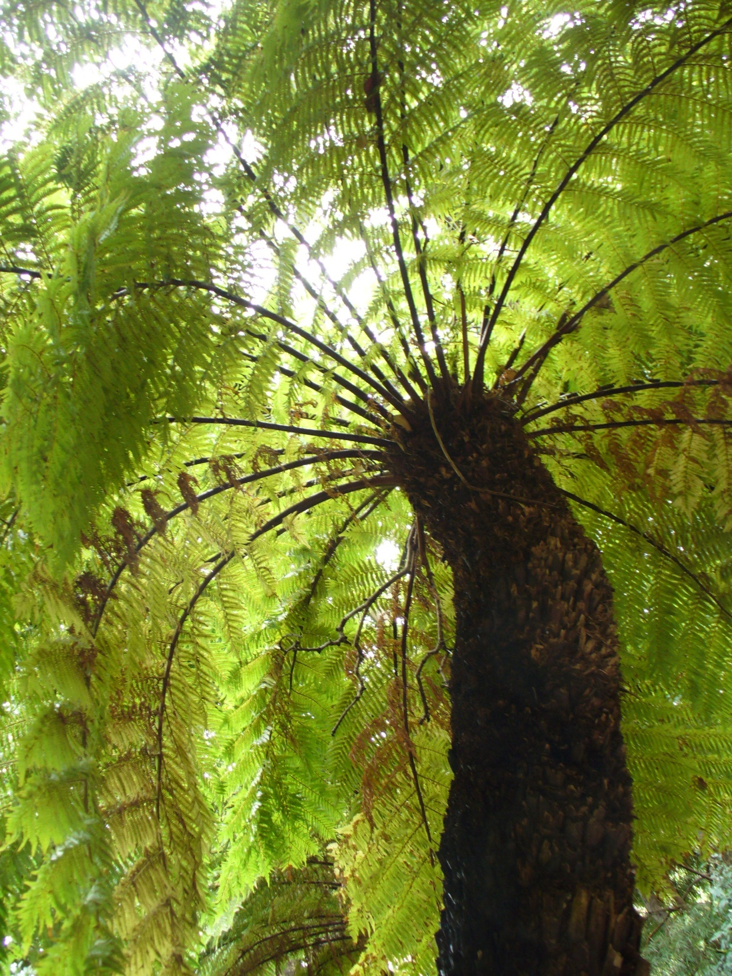
where cool tree-ferns rise to welcome the rain,

Slide 11
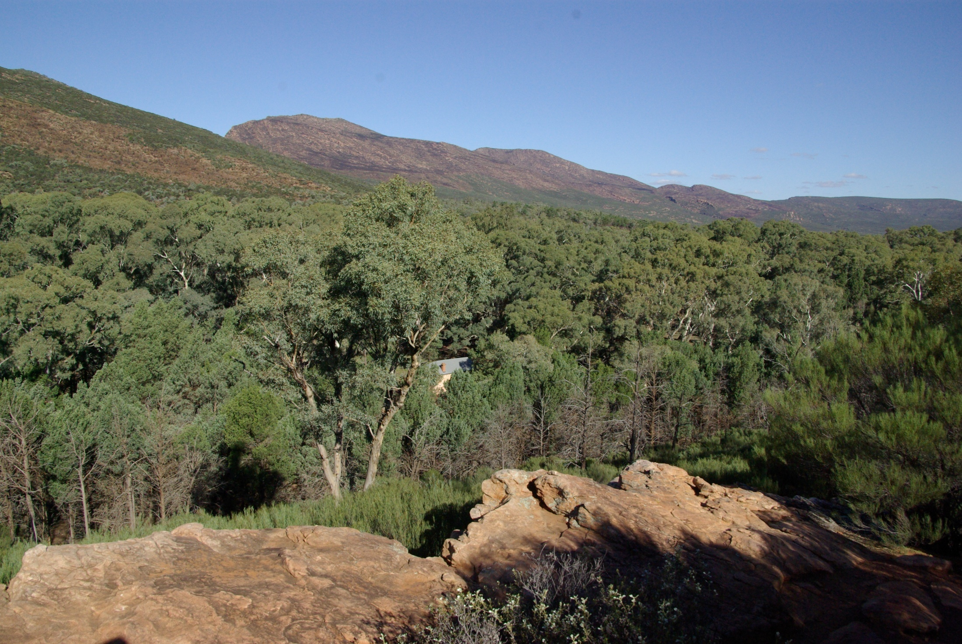
let bushland, farm, mountain-top, all of their days

Slide 12
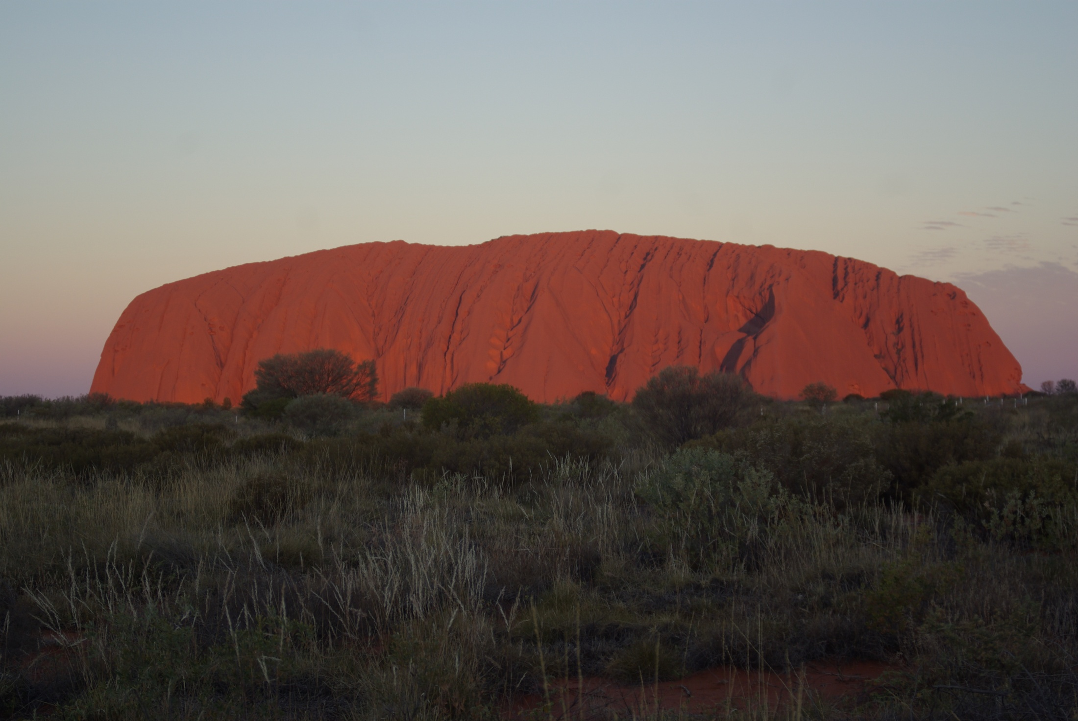
delight in the Spirit who formed them for praise.

Slide 13
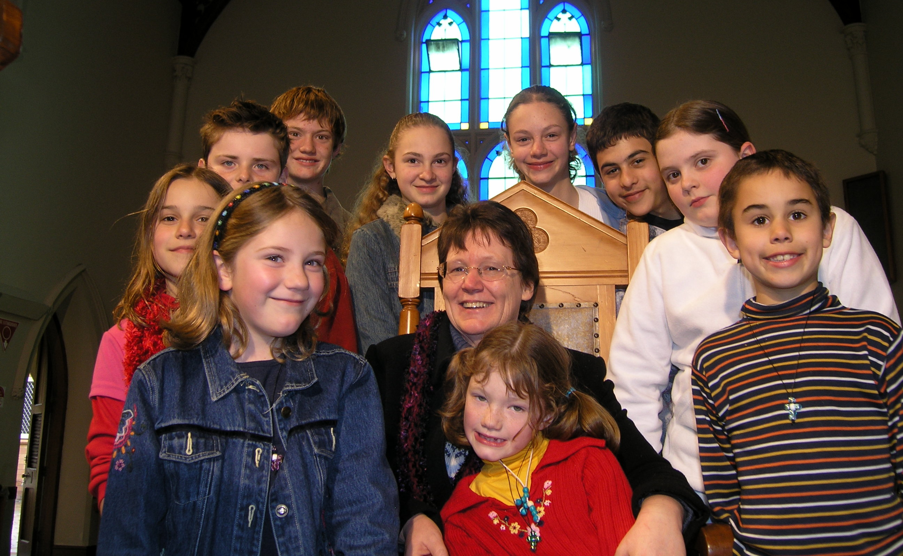
Now, people of faith, come gather around

Slide 14
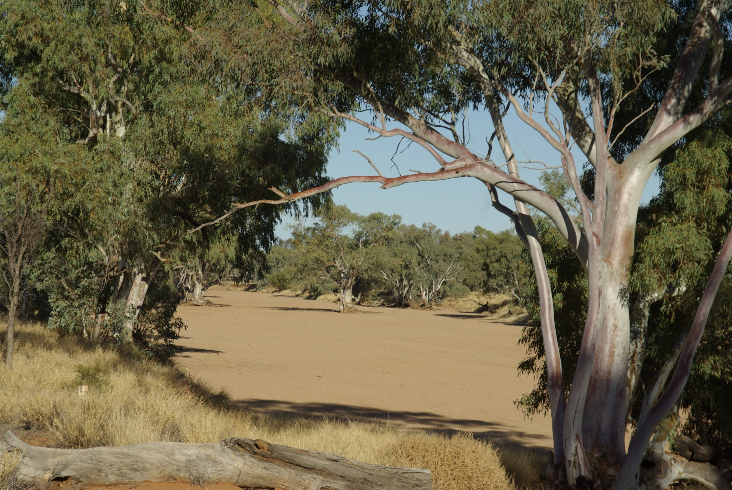
with songs to be shared, for blessings abound!

Slide 15

Australians, whatever your culture or race,

Slide 16
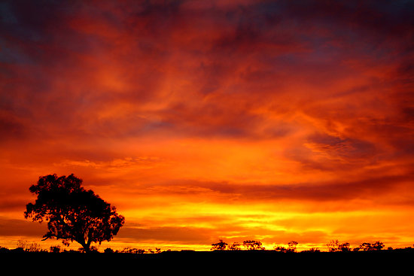
come, lift up your hearts to the Giver of grace.
Elizabeth J. Smith 1956­ Reproduced with permission under license # 604530Licensing - Copyright Cleared Music for Churches.

